Slide 1
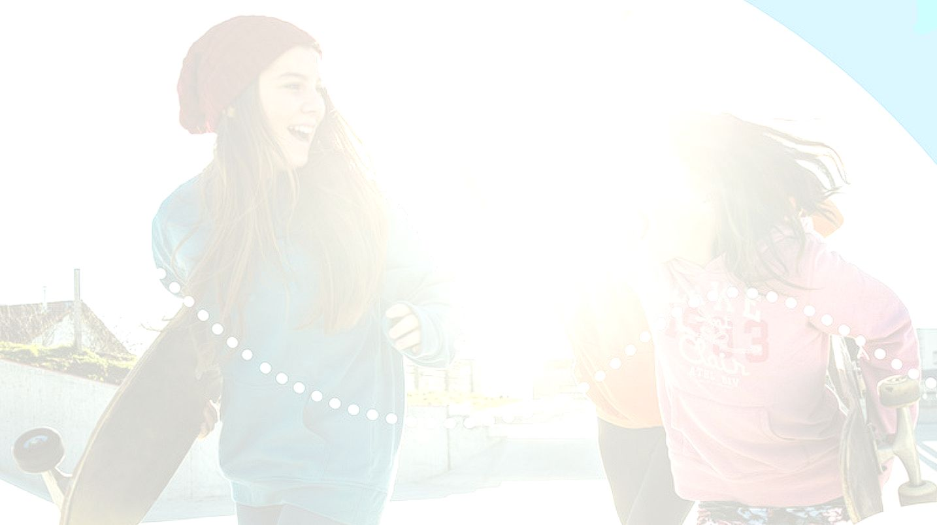

UNIT 1; All about me
Hanging out

Slide 2
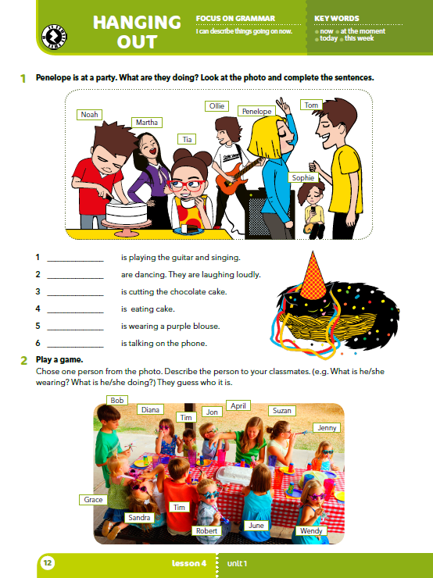
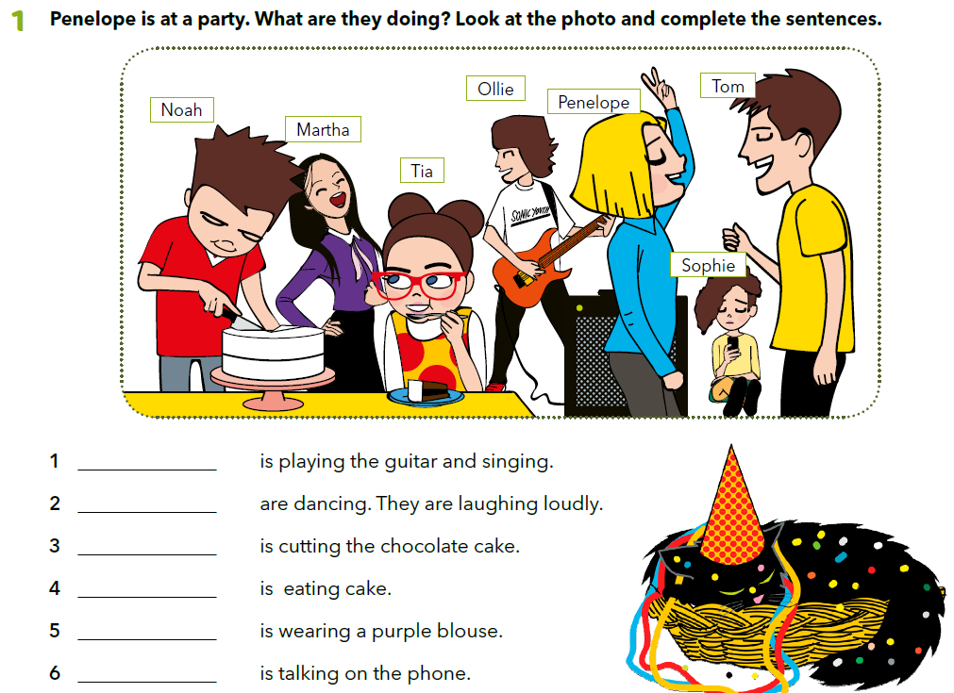
Where are you? Who is with you? What are you doing? What is he/she doing?
Penelope is at a party. What are they doing? Look at the photo and complete the sentences.
Olie
Penelope and Tom
Noah
Tia
Martha
Sophie

Slide 3


Olie is playing the guitar and singing.
Penelope and Tom are dancing. They are laughing loudly.
Noah is cutting the chocolate cake.
Ako glagol završava na jedan suglasnik ispred kojeg stoji kratak, naglašen samoglasnik, krajnji se suglasnik ispred –ing udvostručava:
stop – stopping
Krajnje –l se uvijek udvostručava:
travel – travelling
Ukoliko glagol završava na –e, ono se gubi i dodaje se nastavak –ing:
come – coming
Ukoliko glagoli završavaju na –ie, nastavak prelazi u y i dodaje se nastavak – ing:
die – dying

Slide 4
You are cooking.
Are you cooking?
What are you cooking?
I am not doing my homework at the moment.
Practise PRESENT CONTINUOUS
https://create.kahoot.it/share/what-are-they-doing/057bb18b-aa1e-43d8-8bc5-72f9b9386aea

Slide 5
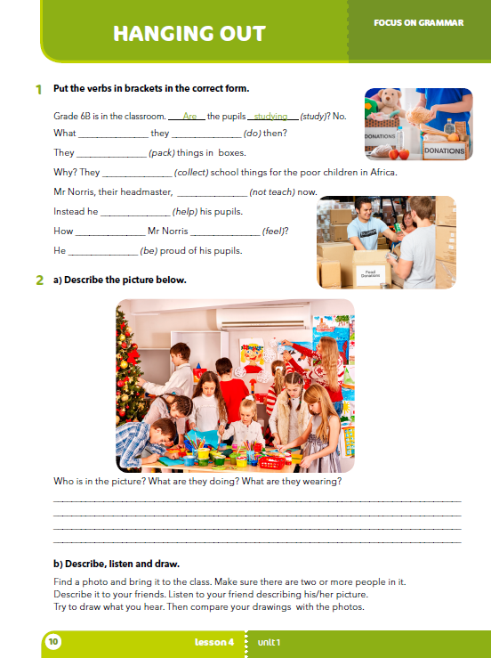
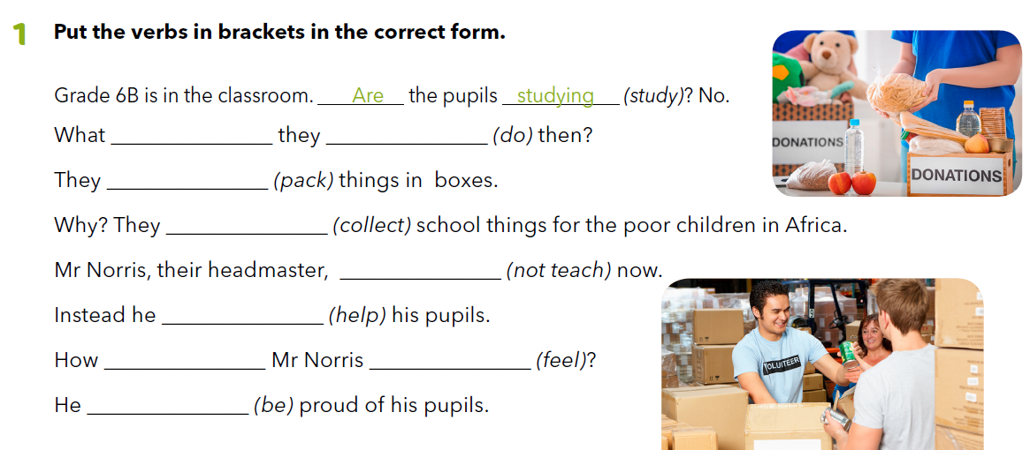
In task 1, you have to put the verbs in brackets in the correct form.
are doing
are packing
are collecting
isn’t teaching
is helping
does feel
is

Slide 6
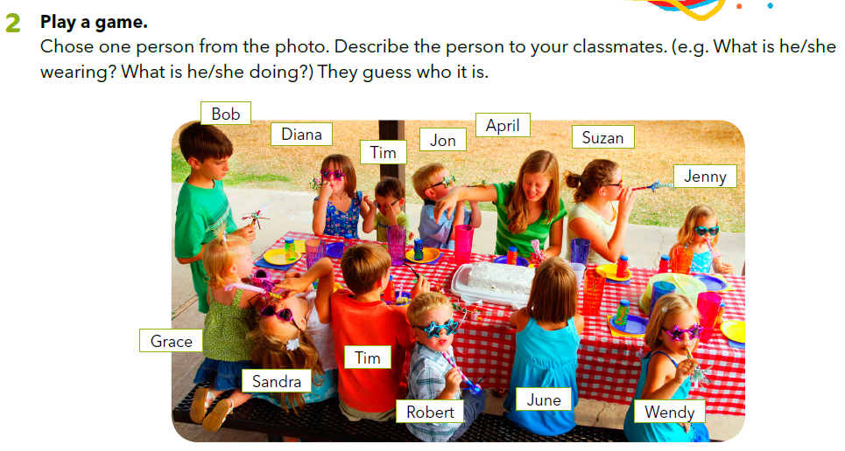
LEARN MORE
https://www.e-sfera.hr/dodatni-digitalni-sadrzaji/24281eac-0a98-4385-8c84-2372a7c3a1e7/
Chose one person from the photo in task 2. Describe the person in your notebook. (What is he/she wearing? What is he/she doing?)

Slide 7
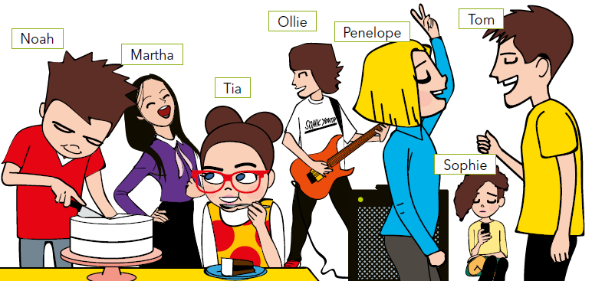
What are the children in the picture doing?
What do you usually do at your birthday parties?
Do you dance?
Do you sing?
Do you play games?
When do you usually have parties or go to parties – at weekdays or at weekends?
What do you usually do at weekends?
What does your family usually do at weekends?
Noah is cutting the chocolate cake.
Martha is wearing a purple blouse.
Tia is eating cake.
Olie is playing the guitar and singing.
Penelope and Tom are dancing. They are laughing loudly.
Sophie is talking on the phone.

Slide 8
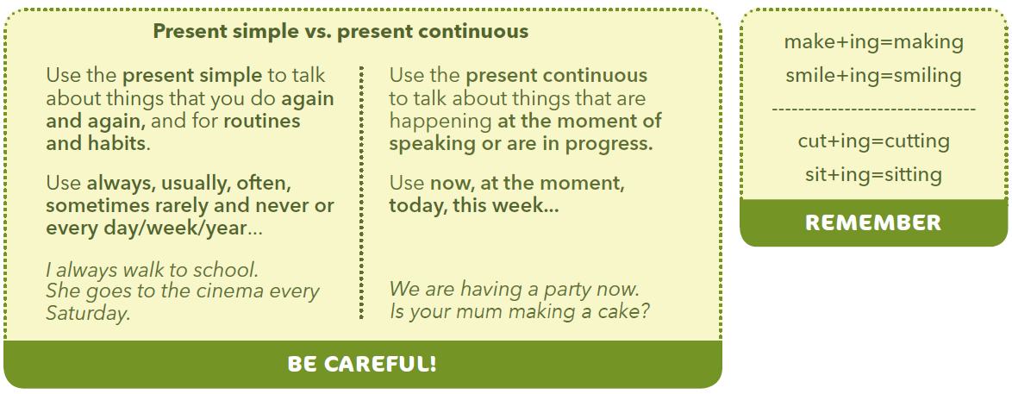
Penelope and Tom are dancing.
I usually dance at birthday parties.
Tia is eating cake.
I often eat cake at birthday parties.
PRESENT CONTINUOUS koristimo kada govorimo o radnji koja se odvija upravo sada, tj. u trenutku u kojem govorimo ili koja je prikazana na fotografiji koju opisujemo (now, at the moment, in this photo…)
PRESENT SIMPLE koristimo kada govorimo o radnji koja se ponavlja (always, usually, often, …)

Slide 9
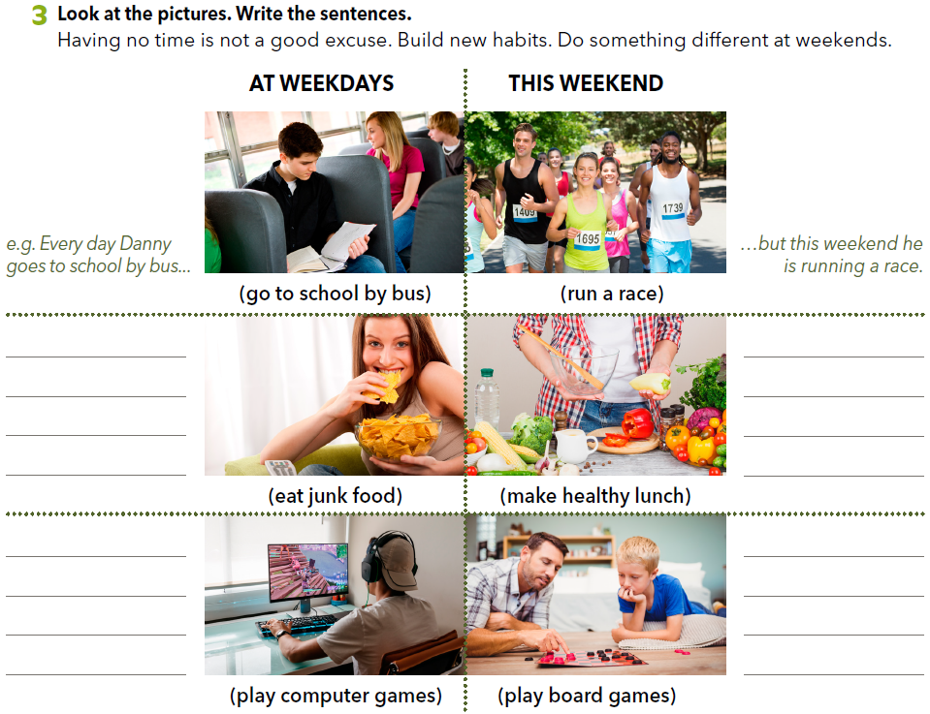
Open your book, page 13!
Every day she
eats junk food...
... but today she
is making a
healthy lunch.

Slide 10
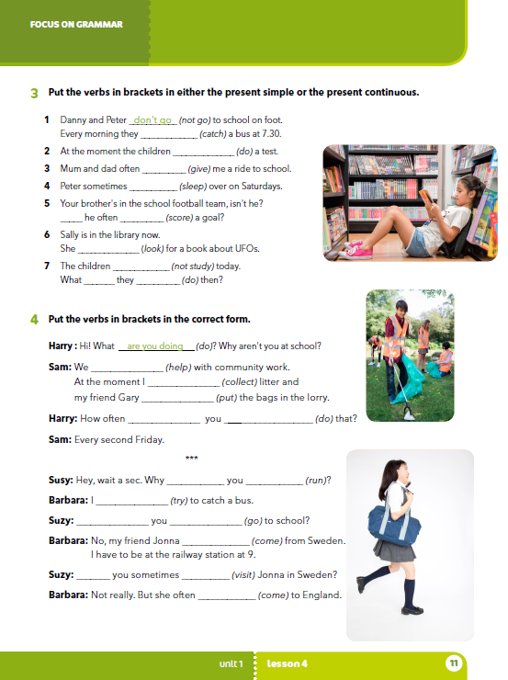
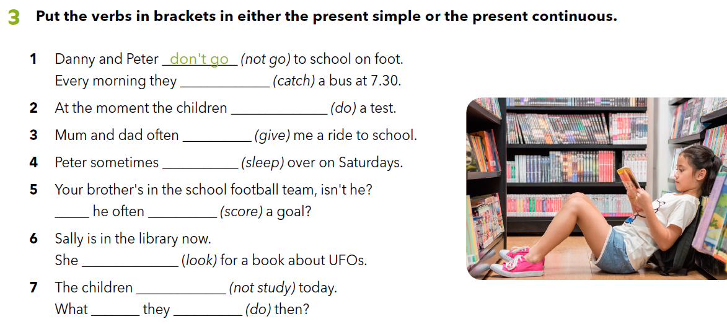
In task 3, you have to put the verbs in brackets in either the present simple or the present continuous.
catch
are doing
give
sleeps
Does score
is looking
aren’t studying
are doing

Slide 11
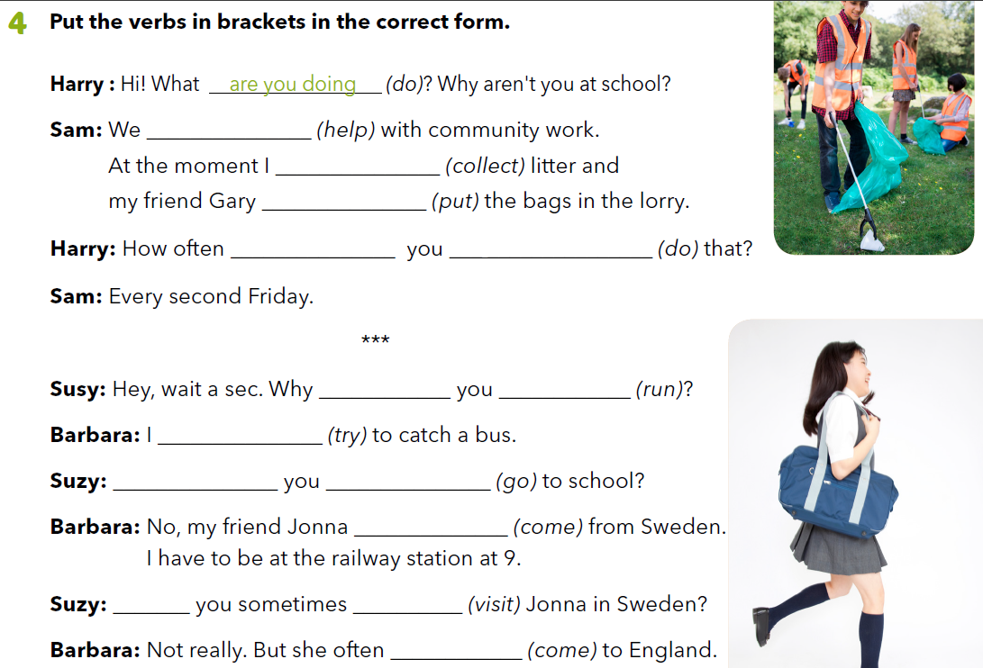
are helping
am collecting
is putting
In task 4, you have to put the verbs in brackets in either the present simple or the present continuous.
do do
are running
am trying
Are going
is coming
Do visit
comes

